Slide 1
Customer Lead Prediction Project
Avinash Gadpayle

Slide 2
Title and Content Layout with List
Problem Statement
Tools Used
Approaches
EDA Insights
Conclusion/Suggestion
Avinash Gadpayle

Slide 3
Problem Statement
The primary objective of this project is to develop a data-driven solution that predicts the likelihood of a lead successfully converting into a paying customer for a business. The conversion of leads into customers is a fundamental aspect of business growth and revenue generation. By harnessing data and machine learning techniques, this project aims to optimize lead conversion rates and lead management efficiency, while also enabling personalized marketing and sales strategies for different lead segments.
Avinash Gadpayle

Slide 4
Tools Used
Data Cleansing: We used pandas and Python to clean and preprocess the dataset. This included handling missing values, removing duplicates, and standardizing data types.
Exploratory Data Analysis (EDA): We employed libraries like pandas, matplotlib, and seaborn to perform in-depth data exploration. This allowed us to gain a deep understanding of the data, identify trends, and analyze correlations.
Visualization: To visualize our findings during EDA and to represent our insights effectively, we made extensive use of visualization libraries like Matplotlib and Seaborn.
Machine Learning: For the heart of our project, building predictive models, we utilized scikit-learn, a popular machine learning library in Python. We specifically employed the RandomForestClassifier as our predictive model.
Avinash Gadpayle

Slide 5
Approaches
Data Cleaning:
Handle missing values.
Remove duplicates.
Standardize data types.
EDA:
Analyze lead demographics.
Explore lead sources and channels.
Investigate lead activity and preferences.
Visualization:
Create visualizations to represent findings from EDA.
Use tools like Matplotlib& Seaborn for visualizations.
Machine Learning:
Split the dataset into training and testing sets.
Select and implement machine learning algorithms for classification.
Tune hyperparameters for optimal model performance.
Evaluate models using appropriate metrics (e.g., accuracy, precision, recall, F1-score).
Avinash Gadpayle

Slide 6
Introduction to EDA Insights
Exploratory Data Analysis (EDA) plays a pivotal role in unraveling the story within the data.
EDA is the initial step in understanding the dataset's characteristics, patterns, and potential correlations.
Demographics Analysis
Lead Source
Lead Orgin
Correlation Matrix
Avinash Gadpayle

Slide 7
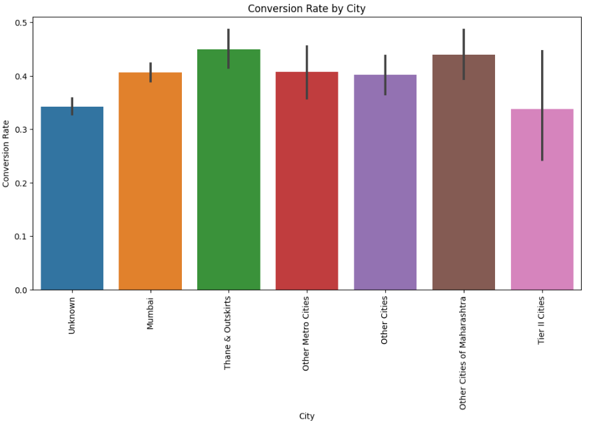
Demographics Analysis

Slide 8
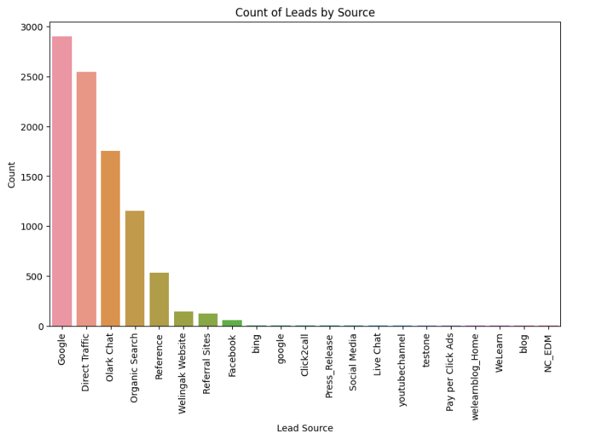
Lead Source

Slide 9
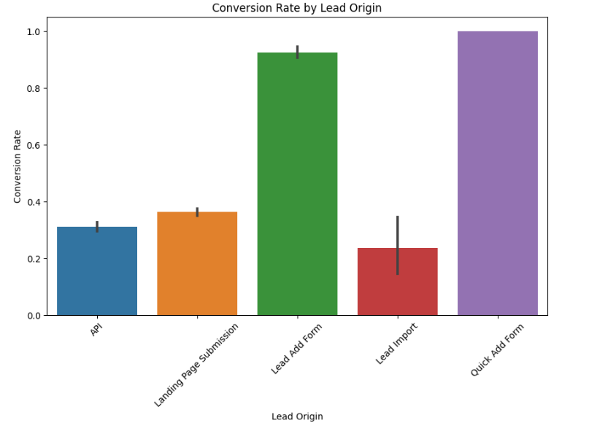
Lead Orgin

Slide 10
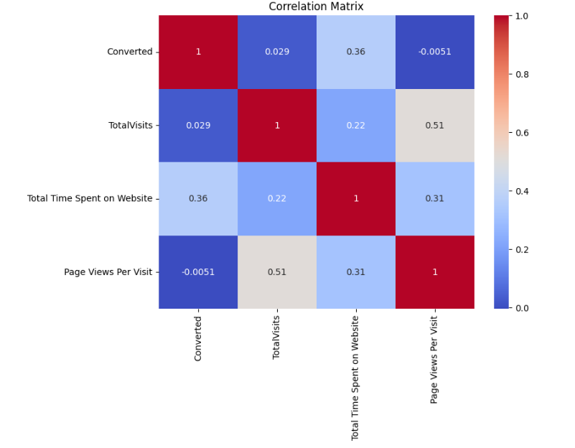
Correlation Matrix

Slide 11
Key Conclusions
Lead Source Impact: Recognize that the choice of lead source significantly influences conversion. Prioritize high-conversion channels like "Direct Traffic" and "Google."
Engagement Matters: Personalized email and SMS interactions have a substantial impact on conversion rates. Implement targeted engagement strategies.
Specialization Focus: The choice of specialization plays a role in lead conversion. Develop content tailored to the most popular specializations.
Localization Counts: Geographical factors are relevant. Design localized campaigns to align with local preferences and language.
Avinash Gadpayle

Slide 12
Top Suggestions
Prioritize High-Conversion Sources: Allocate more resources to leads from sources known to have a high conversion rate.
Personalized Engagement: Implement personalized email and SMS campaigns to boost lead engagement.
Specialization-Centric Approach: Tailor content and offerings to match the preferred specializations of leads.
Localized Campaigns: Create campaigns targeting the geographical location of leads for better resonance.
Avinash Gadpayle

Slide 13
Thank You Avinash Gadpayle

